Slide 1
Triple Integrals (Spherical & Cylindrical) Q&A

Slide 2
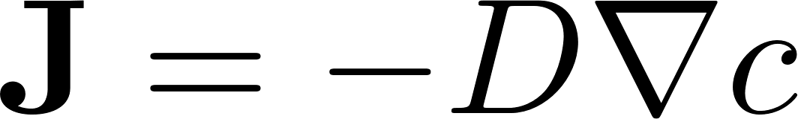
Does the solute diffusion have more applications?

Slide 3
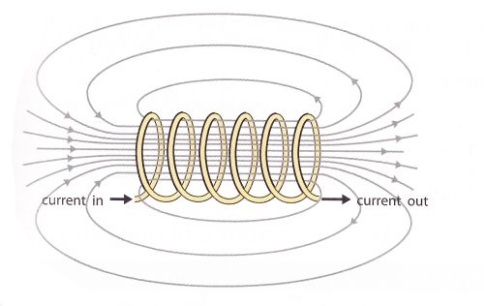
Can cylindrical coordinates be used to describe the flow of electrons in wires?

Slide 4
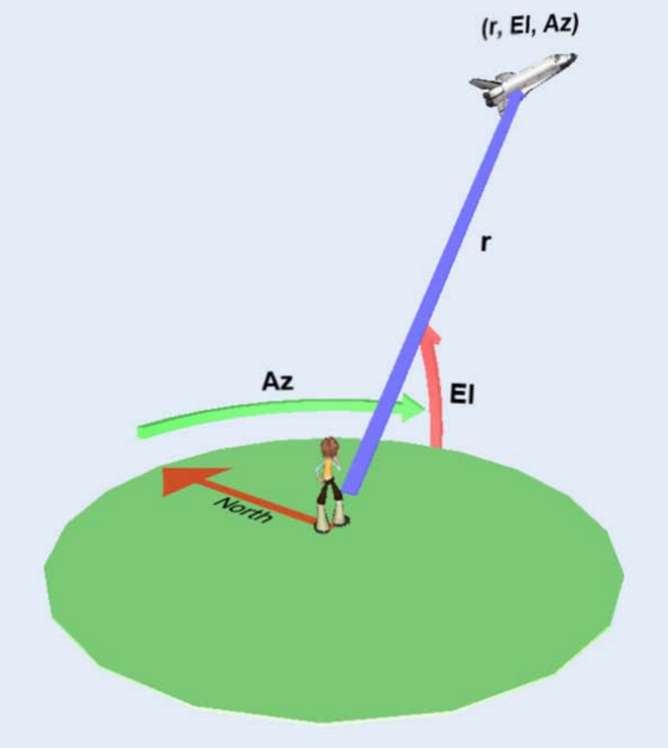
What is the main reason one would use spherical coordinates in relation to space launches?

Slide 5
Line Integrals over scalar fields, Curl, & Divergence

Slide 7
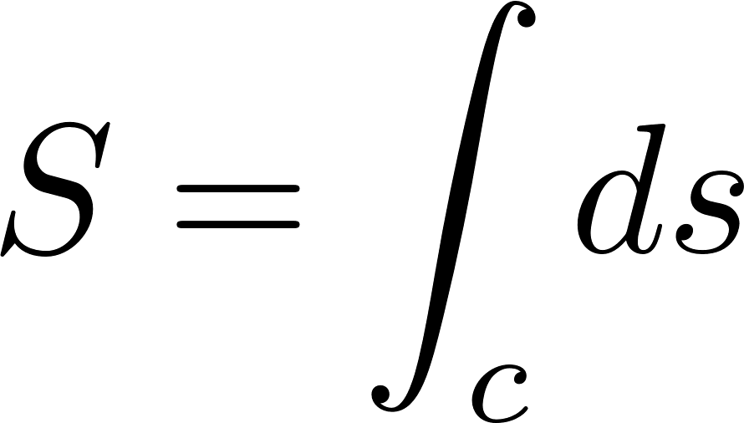
Arclength

Slide 8
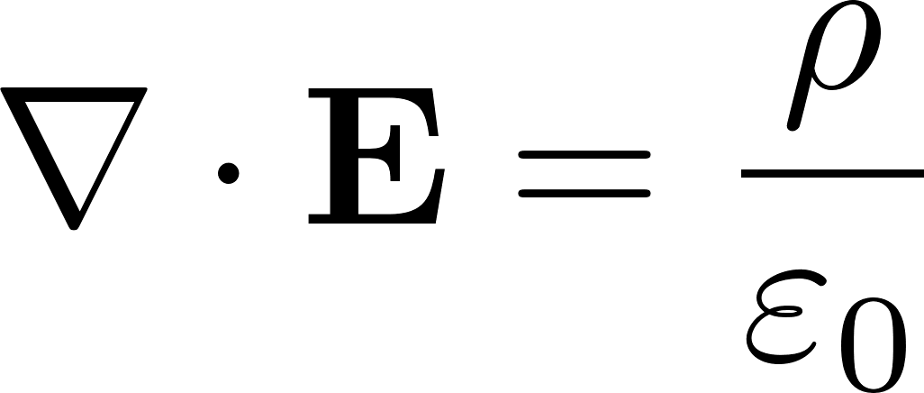
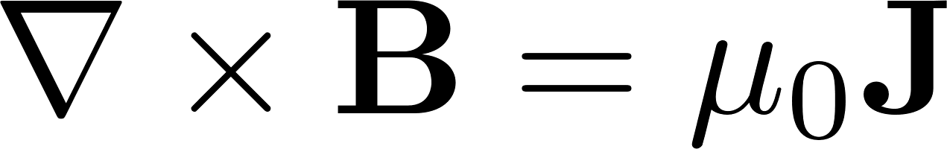
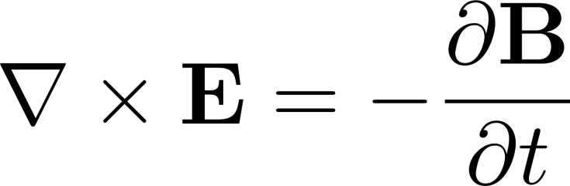

Gauss’s Law
Maxwell’s Equations
Ampere’s Law
Faraday’s Law
Gauss’s Law for Magnetism

Slide 9
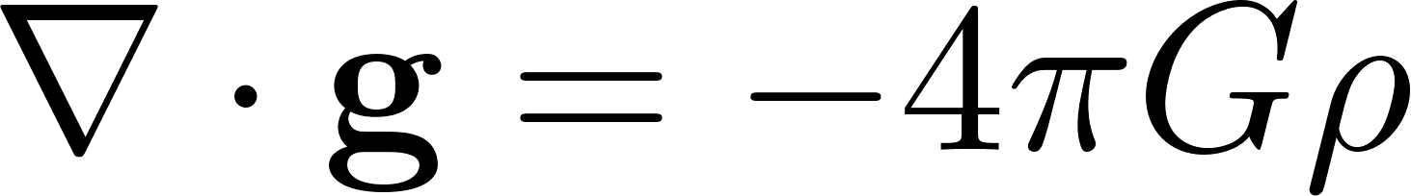
Gauss’s Law for Gravity

Slide 10
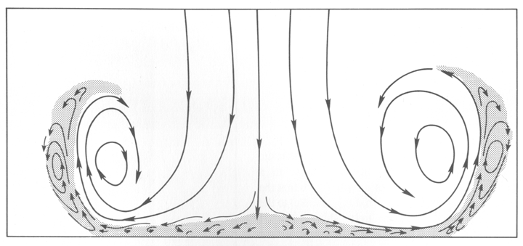
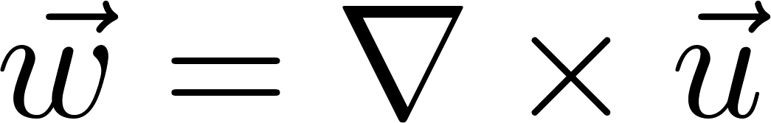
Vorticity

